Slide 1
Notes:
Thank you for respecting our intellectual property.
These slides are provided as a service to Kirkpatrick Certified Consultants to help them to gain support and partnership within their own organizations.

Slide 2


Kirkpatrick Four Levels® Evaluation Certification Program
Bronze Level
Notes:
Guidelines for what to do and say
Start by providing an overview of why you obtained Kirkpatrick certification and a bit about your experience in the program.
Set the context for the following slides.

Slide 3

Level 1: Reaction
The Kirkpatrick Model
The degree to which participants find the training favorable, engaging and relevant to their jobs
Notes:
Guidelines for what to do and say
If the audience is not already familiar with the four levels, use these slides to introduce them.

Slide 4

Level 2: Learning
The Kirkpatrick Model
The degree to which participants acquire the intended knowledge, skills, attitude, confidence and commitment based on their participation in the training

Slide 5
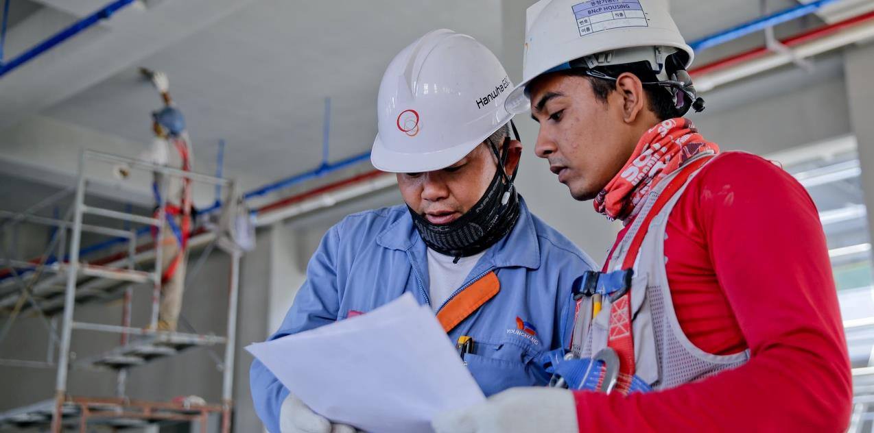
Level 3: Behavior
The Kirkpatrick Model
The degree to which participants apply what they learned during training when they are back on the job

Slide 6

Level 4: Results
The Kirkpatrick Model
The degree to which targeted program outcomes occur and contribute to the organization’s highest-level result
Notes:
Guidelines for what to do and say
Ask the group where they are today in terms of measuring each of the four levels.
To what level do they typically measure?
What is the highest level they have ever measured for any program?
Ask them to briefly offer ideas as to why Levels 3 and 4 are ignored, if that is the case in your organization.

Slide 7

Notes:
Guidelines for what to do and say
This bridge photo illustrates how many training initiatives operate. They start strong and clear. There is direction. Everyone can see what is going on.
But then, after the training program, it starts to fade away. The training is never mentioned again. People aren’t clear on where they are going, or the final result they are to accomplish.
There is no connection between the training and the final destination.

Slide 8

Notes:
Guidelines for what to do and say
This picture illustrates what we want to see happen. This is a metaphor for the business partnership model. There is a bridge between training on the right side of the stream, and on-the-job performance and impact expectations on the left. Everyone can see where they are going and how to get there, because the bridge is visible, and so is the destination.
Using all four of the Kirkpatrick levels in the planning and execution stages can create this clarity. Note that there is a bit of rough water and sharp rocks in between training and on-the-job execution if training graduates choose to wade across the river rather than take the bridge!
Also consider pointing out that there is a good correlation between Levels 1 and 2 (right side). If indeed good and proper efforts are made at creating the right learning environment, learning is likely to occur. Similarly, there is a good connection between Levels 3 and 4 on the left. If you can get employees to consistently perform critical on-the-job behaviors, chances are good that positive impact will follow.
The problem is that there is little or no positive correlation between Levels 2 and 3. Thus, in reality, the bridge you see does NOT exist. Knowing what to do and how to do it (L2) seldom translates to actual application and performance (L3). This is why it’s important for learning professionals to be bridge builders or civil engineers.
This involves spending time in the world of work (the left side of the bridge) building positive relationships, listening to and learning what the needs and pain points are, speaking the language of the internal or external customer, and making a business case for a partnership approach to learning and performance.
It is important to stress the following points:
Most learning functions spend way too much time on the right side of the river. This has to change, or the danger is that they will be replaced by an app.
Time must be spent on the left side, learning the language, discovering needs and showing support for L3 and L4.
The focus should be on performance support, leading up the hill to the flag at the top of the mountain- the ultimate, measurable criteria for business or mission success (L4).
This is also the model to save money! It greatly reduces training and evaluation efforts that do not lead to business results.

Slide 9



Why Evaluate?
Improve
the Program
Improve Job Performance
Maximize Organizational Results
Demonstrate relative contribution of each success factor
Effective Training
Training Effectiveness
Notes:
Guidelines for what to do and say
There are numerous reasons for evaluating training programs. These fit into two categories.
Effective training
These are measurements used to determine if the training program was of good quality and well-received. These relate to Kirkpatrick Levels 1 and 2. These are the most common measurements.
2. Training effectiveness
These measurements show if the training program has helped people to perform effectively on the job and contribute to the highest goals and mission of the organization. This relates to Kirkpatrick Levels 3 and 4. These measurements aren’t made as often, but they are the ones most wanted by organizations and executives.
This is where we believe the training industry needs to focus right now to remain viable. We also believe that your training function (and you as a training professional) must decide where you are going to put your flag in the ground. It will likely have enormous implications for your future.
(Consider opening a discussion about where your organization currently stands in regards to these concepts, and the implications.)
e

Slide 10
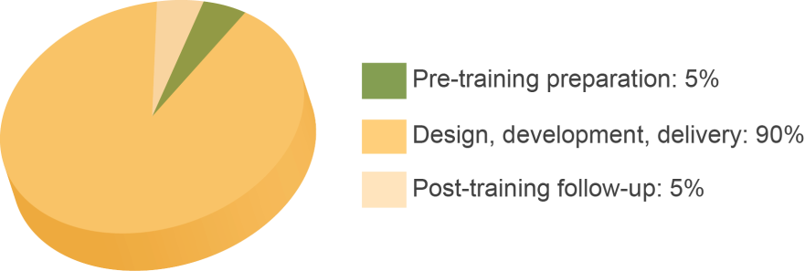
Brinkerhoff Study
Resources Employed – Group 1
- Telling Training’s Story, Rob Brinkerhoff, 2006
Notes:
Guidelines for what to do and say
Rob Brinkerhoff, a professor at Western Michigan University and one of the world authorities on training evaluation, began studying factors that lead to on-the-job application in 1995. Here he conducted a study in 2006 which has been replicated numerous times by various researchers.
They had two groups:
The first group did what most training professionals do: they really focused on the training event - the design, development and delivery of it. They invested very little in what happened before or after the training. We call this “the old training model.”

Slide 11
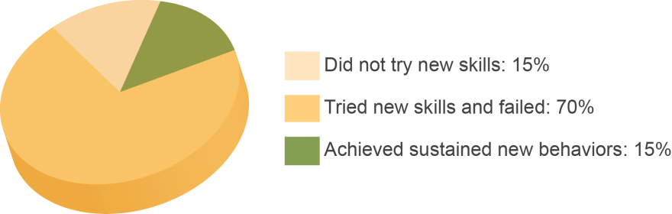
Brinkerhoff Study
Training Application – Group 1
- Telling Training’s Story, Rob Brinkerhoff, 2006
Notes:
Guidelines for what to do and say
Here’s what happened for group 1. After the training was complete:
15% of the training graduates never bothered to try to perform the new behaviors they learned in training.
70% of them tried, but failed for some reason. This was due to a variety of factors in the job environment. For example, they may have had a boss who said that they would do things a different way in their department. They may not have felt comfortable doing the new skill, so reverted to the “old way”. They may not have had the necessary equipment or tools. Or perhaps they just did not see a reason to put forth the effort to try something new, and there was no punishment for continuing to do what had always been done.
Only 15% of the training graduates in this group managed to sustain new behaviors on the job.

Slide 12
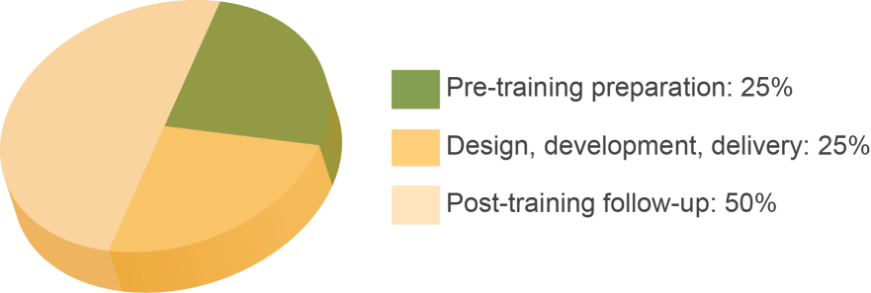
Brinkerhoff Study
Resources Employed – Group 2
- Telling Training’s Story, Rob Brinkerhoff, 2006
Notes:
Guidelines for what to do and say
The second group, which, by the way, took a lot longer to find, used a different approach to the training.
They invested a quarter of their time in talking with business leaders to identify targeted Level 4 outcomes, preparing training participants and their supervisors for what would happen during training and their roles before, during and after it.
They invested another quarter of their resources in the training event itself.
They reserved half of their resources to support performance of critical behaviors on the job.

Slide 13
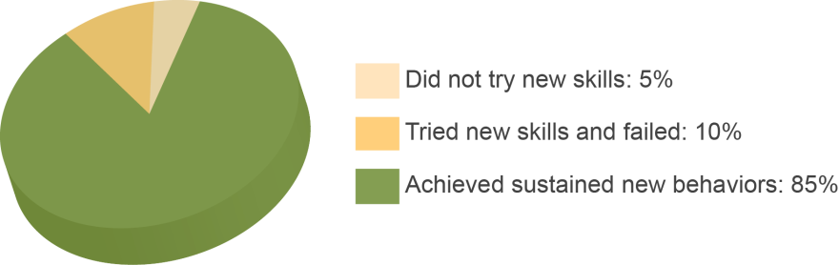
Brinkerhoff Study
Training Application – Group 2
- Telling Training’s Story, Rob Brinkerhoff, 2006
Notes:
Guidelines for what to do and say
The results for the second group were dramatically different than the first. Remember, they did not use more resources; they simply used them differently.
Only 5% of the training graduates never bothered to try the new skills.
Only 10% tried, but failed for some reason.
A full 85% of the training graduates were successful in sustaining the new behaviors on the job. Many (most?) of the 70% that were lost in the earlier model were saved here due to even a small amount of support.
What are the implications? (Take a few volunteers from the group. Look for responses like: we need to stop focusing on just the training event. Training professionals and department managers need to work together before and after training. We need to do things differently than we are now.)
15% application is NOT going to bring about any significant Level 4 results. And think of the impact this balanced approach will have on those 70% from the first group who were well-meaning and enthusiastic to apply what they learned, only to become discouraged and give up.

Slide 14
Required Drivers
SUPPORT
Reinforce Follow-up modules Work review checklist On-the-job training (OJT) Self-directed learning Refreshers Job aids Reminders Executive modeling | Encourage Coaching Mentoring
 | Reward Recognition Bonuses Pay for performance
ACCOUNTABILITY
Monitor Action learning Interviews Observation Self-monitoring Key performance indicators (KPIs) | Action plan monitoring Dashboard Work review Survey Touch bases/meetings
Notes:
Guidelines for what to do and say
The difference between groups 1 and 2 in the Brinkerhoff study punctuate the importance of what happens before and after training, on the job.
This brings up a key definition: required drivers. These are processes and systems that reinforce, monitor, encourage and reward performance of critical behaviors on the job after training.
Group 1 relied on the training event almost exclusively to bring about the desired change in behaviors, and therefore the ultimate result. As you saw, this was not terribly successful.
Group 2 recognized the critical role of required drivers, and dedicated 75% of their training resources to ensuring that the application environment would be conducive, and helping graduates on the job as much as they can. It requires supervisors and managers to be active participants in the process.
The degree to which a solid plan including required drivers is created is the best predictor of program success.
(This is an opportunity to open up a bit of discussion surrounding what your organization does today, and thoughts about how it might be enhanced.)

Slide 15
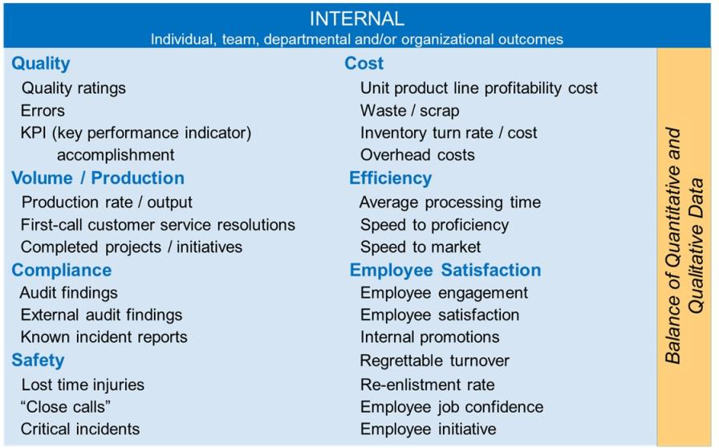
Leading Indicators
Notes:
Guidelines for what to do and say
This brings us to another important point. Every organization has multiple initiatives and programs running concurrently. This can create channel conflict, because some departments think their program is more important than others.
There is a way to align all programs so that they work in harmony and contribute to the highest level goal, and that is by defining leading indicators.
Leading indicators are short term observations and measurements that critical behaviors are on trick to create a positive impact on desired results.
I’ll show you an example of what I mean by this (next slide).

Slide 16
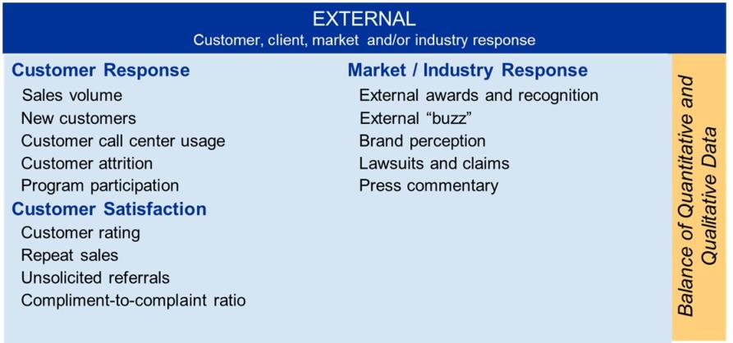
Leading Indicators
Notes:
Wendy find better rendering of this slide that is editable. Margins need work
Recolor to new template colors

Slide 17
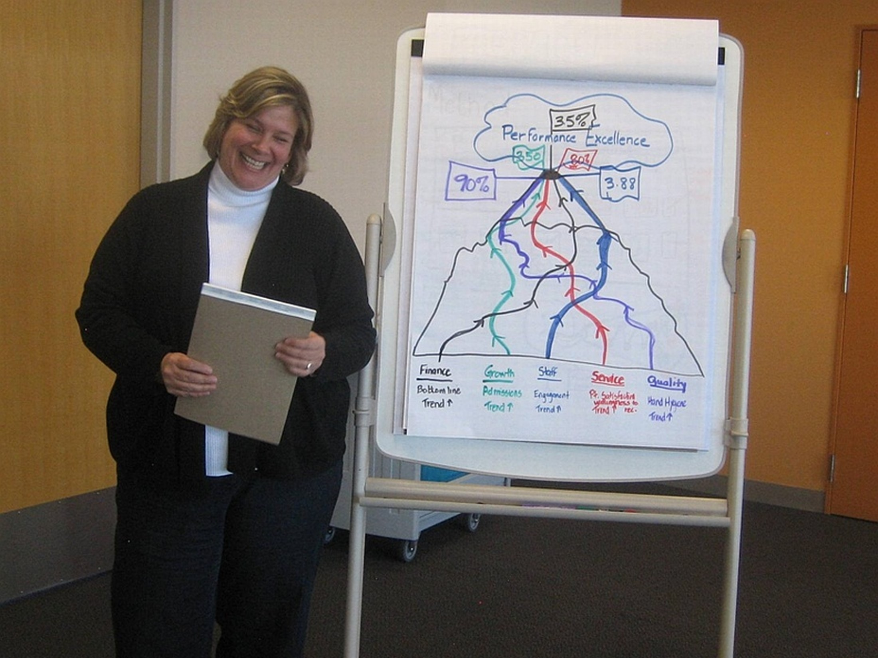
Notes:
Guidelines for what to do and say
This is a picture of a Kirkpatrick certification program participant from Kaiser Permanente Healthcare in the US.
Melissa’s concern, which prompted her to create this picture, was that she was hesitant to commit to a business level target, “since then key stakeholders might expect me to move that needle all by myself.”
A discussion ensued about the fact that no training program, no matter how great, can significantly influence business results on its own. It can, however, be one of many programs or initiatives that make a significant impact on bottom-line results.
In this case, Melissa’s initiative is “service”, outlined in red. It is reasonable to expect that the service initiative will significantly impact the targeted goal of 35% increase in performance excellence, but a service training program alone with no follow-up or connection to other corporate initiatives will NOT create the desired increase in performance excellence. It requires an integrated approach with involvement of others.
The other four initiatives entitled finance, growth, staff and quality will also contribute to the goal accomplishment. Each program has its own path and means of contribution, yet there are points of intersection where positive collaboration create synergy and help with “the climb to the top”.
(Facilitator note: the L4 result of performance excellence was defined and clarified with two specific, measurable metrics.)

Slide 18
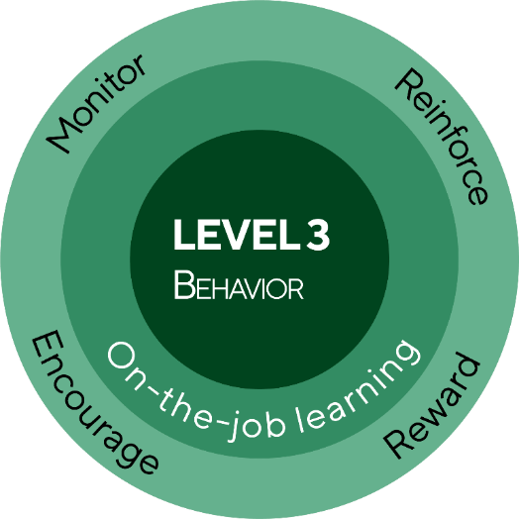
THE NEW WORLD KIRKPATRICK MODEL
LEVEL 1
Reaction
Engagement
Relevance
Customer satisfaction
LEVEL 4
Results
Leading indicators
Desired outcomes
LEVEL 2
Learning
Knowledge
Skills
Attitude
Confidence
Commitment
MONITOR AND ADJUST
Notes:
Guidelines for what to do and say
This diagram puts the four levels together and shows how they are operationalized.
Level 1
L1 and L2 are stacked. This is because in practice they are typically measured at just about the same time: during and after training.
L1 includes not just customer satisfaction, but also relevance and engagement.
Level 2
Level 2 includes all 5 dimensions: knowledge, skills, attitude, confidence and commitment.
Confidence and commitment can form a nice bridge to L3.
Level 3
Level 3 is like a bulls eye in the center of the diagram. This is because it’s the most important level.
You can see that L3 behavior is surrounded by the drivers: monitoring, reinforcing, encouraging and rewarding.
There is also a ring for on-the-job learning as the responsibility of the individual.
Drivers are the key to accomplishing organizational results.
Level 4
Level 4 leading indicators and desired outcomes finish up the diagram. You can see that they are not quite as large or prominent as L3. This is because if L3 is executed well, the results will happen.
The large orange box that says monitor and adjust is the training function. It is their job to track driver execution during L3 and the preliminary results to see if the initiative is moving in the right direction. If not, analysis needs to be done as to why, and adjustments made to the on-the-job activities. Make no mistake. While Levels 1 and 2 form the foundation to organizational success, the real power is found in the orange! This is where business strategy is made or broken.
The green drivers circle is largely the responsibility of supervisors and managers. This is why “monitor” is listed twice. The supervisors monitor employee behavior; training checks with managers to make sure this monitoring is happening.
Summary
In summary, the degree to which the orange box operates effectively - as your early warning detection system, the faster and to a higher degree will the desired results be realized.
This diagram leaves no doubt that there is no shortcut from Levels 1 and 2 to Level 4. This is where the discussion about level and type of effort must be made in order to maximize results. And as you might guess, this is where things often get dicey. Why? Because those who want to put the onus of responsibility on training to solve and resolve business problems will be called on to be involved as they never have before.
Any questions about the new diagram?

Slide 19
Your “Level 3”
Teach principles to someone in your company
Follow-up modules
Free online resources
Kirkpatrick Evaluation discussion group on LinkedIn
Kirkpatrick® Strategic Evaluation Planning Certificate
In-house program
Kirkpatrick® Silver Level Certification
Kirkpatrick® Business partnership analysis, impact study and consulting
Notes:
Guidelines for what to do and say
Here is what I was asked to do at the end of the Kirkpatrick certification program. That is part of why I am talking with you today to tell you about what I learned.
More importantly, though, I cannot execute the model by myself. It requires a team effort.

Slide 20
So What… Now What?
Notes:
Guidelines for what to do and say
Lead a discussion around the key questions:
“So what?” – why is this important, or why should we care?
“Now what?” – what should we do? What are the roles and responsibilities? What needs to change?
Brainstorm those two questions on flip chart pages.
“So what” will focus on the implications of following the model, or not.
“Now what” discusses next steps for your organization to move towards training effectiveness, and accomplishing your highest level goals.

