Slide 1
Trademark and Copyright Warning
© Copyright 2010-2021, Kirkpatrick Partners, LLC. All rights reserved.
This presentation remains the exclusive property of Kirkpatrick Partners, LLC. Distribution or duplication of these slides and content, in whole or in part, in any way is strictly prohibited. These are for the personal use of program attendees only.
The following marks are the property of Kirkpatrick Partners, LLC as related to educational / training materials, programs and books:
Kirkpatrick® BrightLight®
Kirkpatrick Four Levels® Blended Evaluation Plan®
The One and Only Kirkpatrick®
Notes:
These slides are provided for Kirkpatrick Certified individuals to share the Kirkpatrick materials WITHIN THEIR OWN ORGANIZATION.
Using the materials in any other way (i.e., with clients, at trade shows, in articles, on the internet, in discussion groups, etc.) requires prior written permission from Kirkpatrick Partners.
If you are presenting a case study which is based on the Kirkpatrick Four Levels, you may describe the model only to the degree necessary for the audience to understand the methodology used.
Teaching the Kirkpatrick Four Levels and using any of the proprietary images contained in this presentation for any purpose outside of your own organization is a violation of U.S. trademark law.
If you have any questions about appropriate or inappropriate use of these materials, please contact us.

Slide 2
Authentic Kirkpatrick® Slides to Use Within Your Organization
Jim and Wendy Kirkpatrick

Slide 3
Why Evaluate?
Improve
The Program
Maximize Workplace Performance
Demonstrate Program Value
Effective Training
Training Effectiveness
Notes:
Time/Duration
Facilitator notes
Guidelines for what to do and say
Just a few minutes ago we brainstormed many reasons why we evaluate our training programs. These fit into two categories.
The first is what we call effective training. These are measurements used to determine if the training program was of good quality and well-received. These relate to Kirkpatrick Levels 1 and 2. These are the most common measurements.
The second category is called training effectiveness. These are measurements that show if the training program has helped people to perform effectively on the job to contribute to the highest goals and mission of an organization. This relates to Kirkpatrick Levels 3 and 4. These measurements aren’t made as often, but they are the ones most wanted by organizations and executives. This is where we believe the training industry needs to focus right now to remain viable. We also believe that your training function, and you as a training professional, must decide where you are going to put your flag in the ground. It will likely have enormous implications for your future.

Slide 4
Level 1: Reaction
The Kirkpatrick Model
The degree to which participants find the training favorable, engaging and relevant to their jobs
Notes:
Guidelines for what to do and say
If the audience is not already familiar with the four levels, use these slides to introduce them.

Slide 5
Level 2: Learning
The Kirkpatrick Model
The degree to which participants acquire the intended knowledge, skills, attitude, confidence and commitment based on their participation in the training

Slide 6
Level 3: Behavior
The Kirkpatrick Model
The degree to which participants apply what they learned during training when they are back on the job

Slide 7
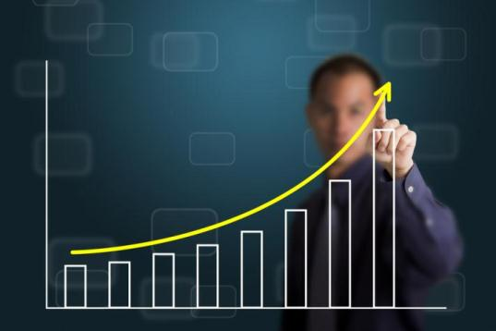
The Kirkpatrick Model
Level 4: Results
The degree to which targeted outcomes occur as a result of the training and the support and accountability package
Notes:
Guidelines for what to do and say
Ask the group where they are today in terms of measuring each of the four levels.
To what level do they typically measure?
What is the highest level they have ever measured for any program?
Ask them to briefly offer ideas as to why Levels 3 and 4 are ignored if that is the case in your organization.

Slide 8
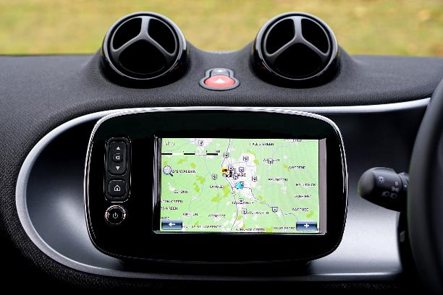
1
The end is the beginning.
KIRKPATRICK FOUNDATIONAL PRINCIPLE
Notes:
Note: the principles are listed as they are on our website and do not follow PowerPoint or template standards for capitalization. https://kirkpatrickpartners.com/Our-Philosophy/Kirkpatrick-Foundational-Principles
8

Slide 9
2
Return on expectations (ROE) is the ultimate indicator of value.
re turn on ex·pec·ta·tion
\ri-tərn ȯn ek-spek-tā-shən\ - noun
1. What a successful training initiative delivers to key business stakeholders demonstrating the degree to which their expectations have been satisfied
KIRKPATRICK FOUNDATIONAL PRINCIPLE
Notes:
9

Slide 10
3
Business partnership is necessary to bring about positive ROE.
KIRKPATRICK FOUNDATIONAL PRINCIPLE
Notes:
10

Slide 11
4
Value must be created before it can be demonstrated.
KIRKPATRICK FOUNDATIONAL PRINCIPLE
Notes:
11

Slide 12
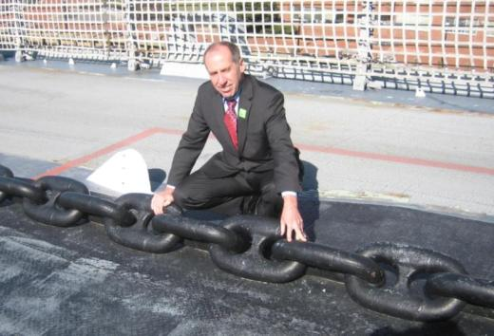
5
A compelling chain of evidence demonstrates your bottom-line value.
KIRKPATRICK FOUNDATIONAL PRINCIPLE
Notes:
Time / Duration
Facilitator notes
Additional information can be found in Chapter 12 of Kirkpatrick Then and Now.
This is a picture of Jim on the deck of the USS Wisconsin in Norfolk, VA. It was built in 1943. Each chain link weighs 120 lbs. – the heaviest chain in the world! (You should have seen how surprised the onlookers were when he threw it over his shoulder and started carrying it around - kidding!)
Guidelines for what to do and say
The final foundational principle is “A compelling chain of evidence demonstrates your bottom-line value.”
12

Slide 13
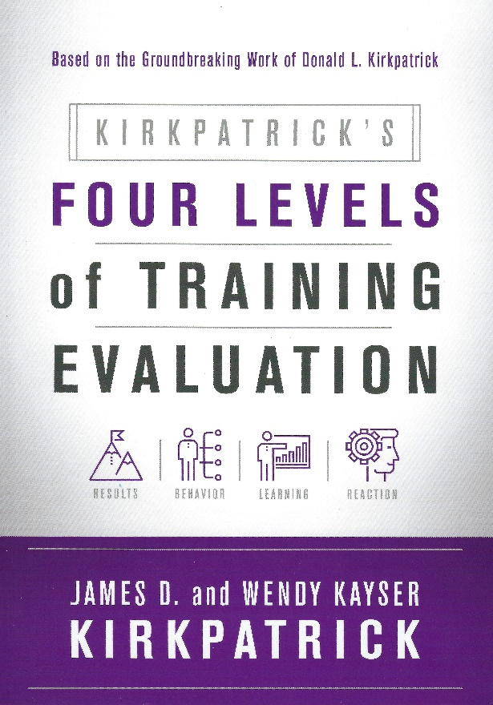
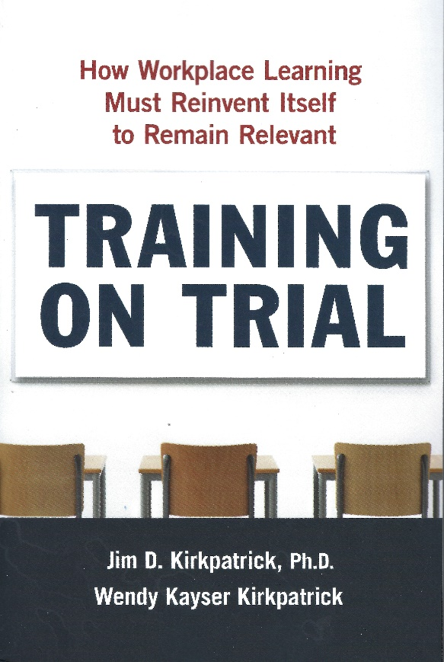
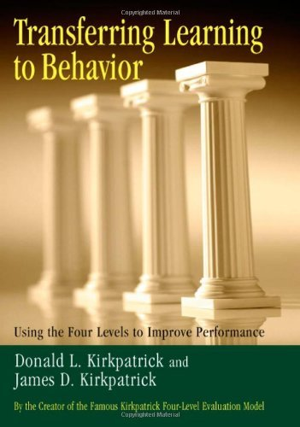
References
Visit kirkpatrickpartners.com to register for our e-newsletter and hundreds of free resources

Slide 14
Thank you
information@kirkpatrickpartners.com
(770) 302-3500
kirkpatrickpartners.com

